Slide 1
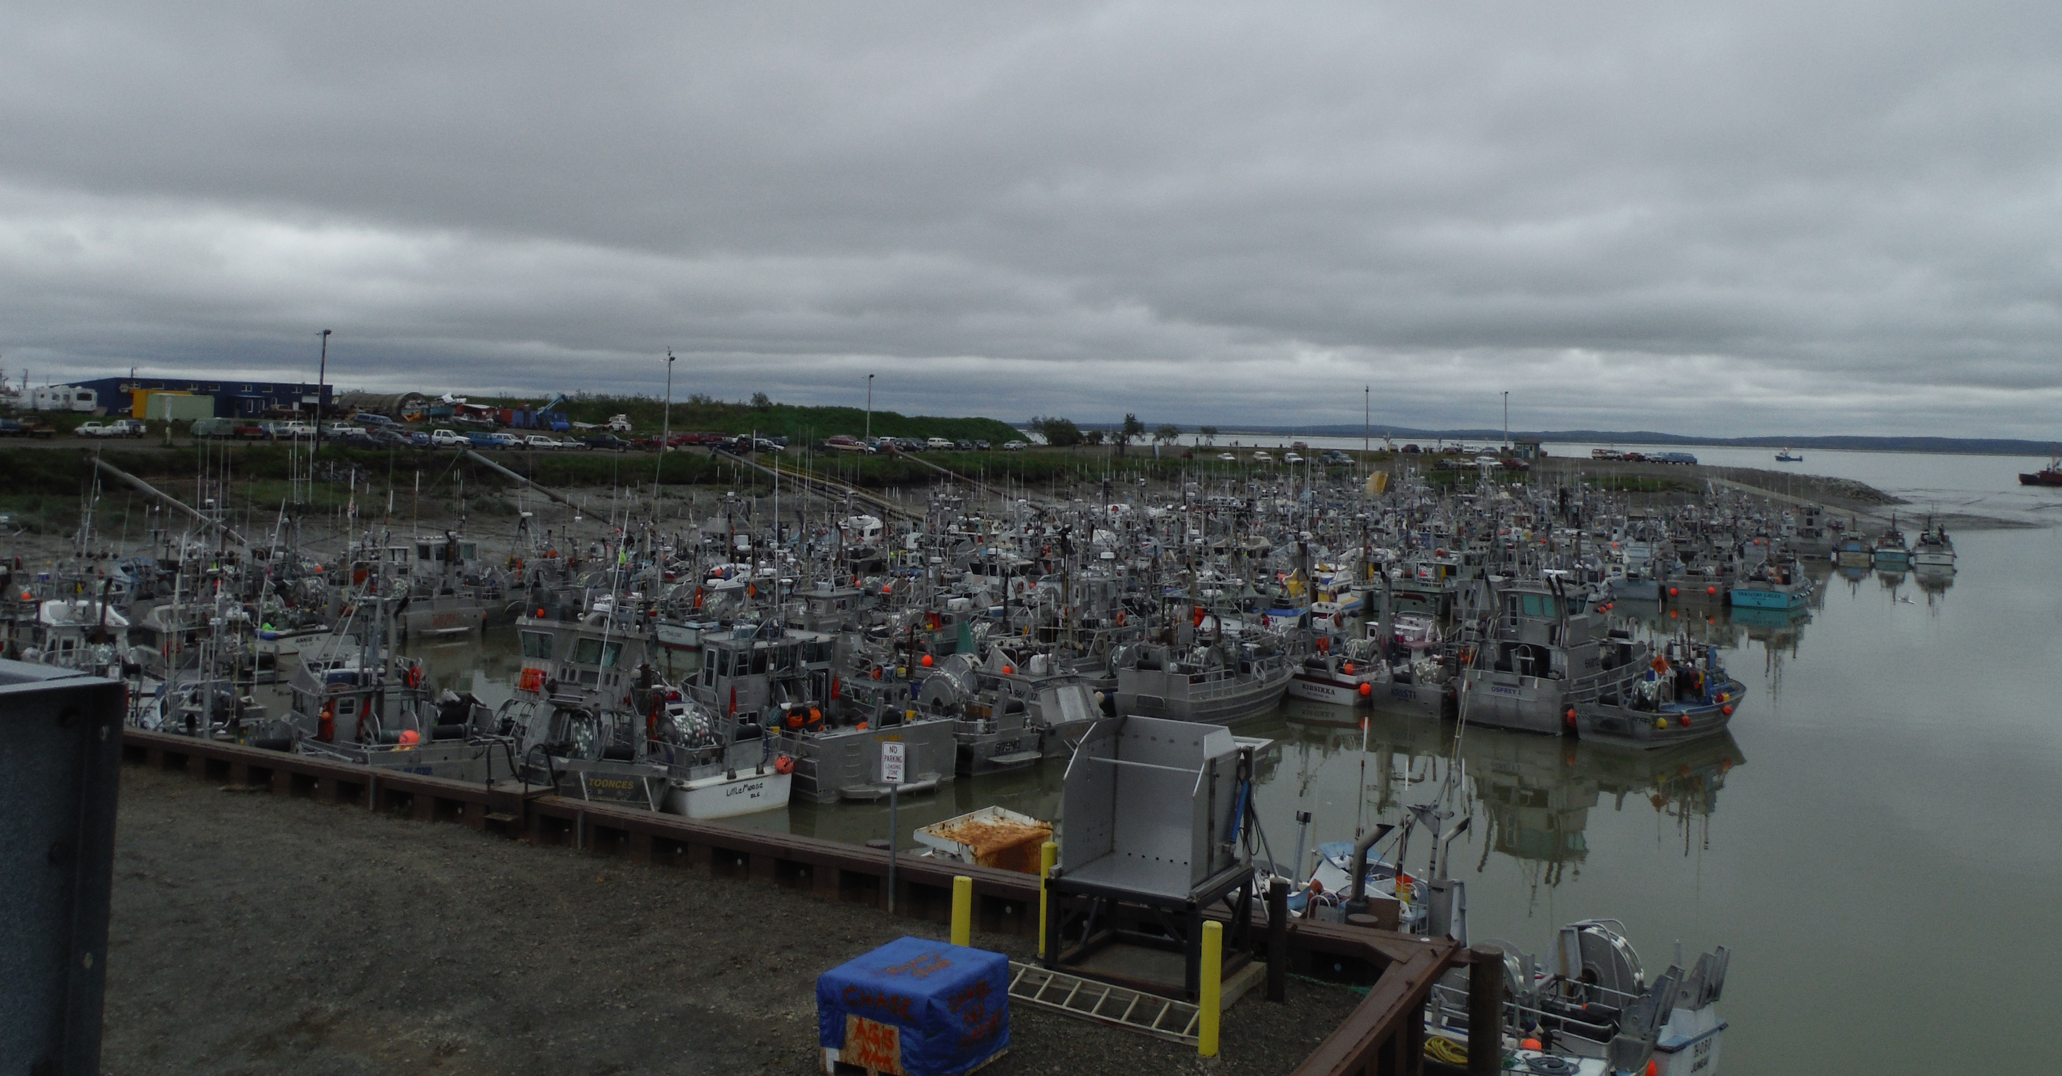
City of Dillingham’s Petition to Annex Nushagak Waters
Hearing before the Local Boundary Commission, November 29, 2016
Notes:
JUNE 22, 2016

Slide 2
EXHIBIT D-1
Notes:
EXHIBIT D-1

Slide 3
Excerpt from Resolution No. 2016-07.
The following capital improvement projects and project funding needs are identified as priorities for the FY2017 State Legislative Request:
1 | Wastewater System Upgrades | $1,000,000
2 | Public Safety Building Replacement | $21,000,000
3 | Outfall Protection | $100,000
4 | Downtown Street Paving | $1,032,360
5 | Landfill Cell Expansion | $95,700
6 | Water System Improvements | $1,365,000
7 | All Tide Dock Protection | $95,700
8 | Sewer Expansion | $2,100,000
9 | Harbor Float Replacement | $100,000
10 | Public Works Mechanics Truck | $35,000
11 | Public Safety Vehicle | $44,000
12 | Dillingham City School Energy Efficient Improvement | $75,000
EXHIBIT D-2
Notes:
EXHIBIT D-2

Slide 4
City of Dillingham
FY2016 AMENDED BUDGET
(As listed in Ord. No. 2016-04)
EXHIBIT D-3 Page 1 of 4
Notes:
EXHIBIT D-3 PAGE 1 OF 4

Slide 5
FY 2016 AMENDED BUDGET
(As Listed in Ord. No. 2016-04)
EXHIBIT D-3 Page 2 of 4
Notes:
EXHIBIT D-3 PAGE 2 OF 4

Slide 6
FY 2016 AMENDED BUDGET
(As listed in Ord. No. 2016-04
EXHIBIT D-3 Page 3 of 4
Notes:
EXHIBIT D-3 PAGE 3 OF 4

Slide 7
FY2016 AMENDED BUDGET
(As listed in Ordinance No. 2016-04)
EXHIBIT D-3 Page 4 of 4
Notes:
EXHIBIT D-3 PAGE 4 OF 4

Slide 8
Chapter 4.07 DILLINGHAM MUNICIPAL CODE
REGIONAL FISHERIES IMPROVEMENT FUND
4.07.010 Definitions.
“Regional fisheries improvement fund” means a fund to be used only for capital projects, including planning, designing, engineering and associated costs that are anticipated to improve the commercial and subsistence fisheries within the city.
“Regional priorities” means an annual compilation of the fisheries improvement capital projects formulated after public hearings in Dillingham and outreach with communities within the Bristol Bay region including Aleknagik, Clark’s Point, Ekuk, Ekwok, Koliganek, Manokotak, New Stuyahok and Portage Creek for presentation to the state legislators and Governor.
4.07.020 Establishment of fund.
There shall be established a regional fisheries improvement fund beginning July 1, 2012. Monies to be deposited into this fund will be from revenues to be collected as raw fish tax and held as an unappropriated reserve in an amount not less than five percent of total fish tax revenue collected in the previous fiscal year or any other amount the council deems appropriate.
4.07.030 Annual transfer.
Annually at the adoption of the fiscal budget a portion of the anticipated unappropriated reserve derived from funds collected as raw fish tax may be transferred to this fund.
EXHIBIT D-4 Page 1 of 2
Notes:
EXHIBIT D-2 Page 1 of 2

Slide 9
Chapter 4.07 DILLINGHAM MUNICIPAL CODE (Continued)
REGIONAL FISHERIES IMPROVEMENT FUND
4.07.040 Adoption of regional priorities, capital improvements program.
The council shall seek input on regional priorities with communities within the Bristol Bay region including Aleknagik, Clark’s Point, Ekuk, Ekwok, Koliganek, Manokotak, New Stuyahok and Portage Creek in conjunction with the adoption of that portion of the city’s fiscal budget to be transferred to this fund.
4.07.050 Use of funds.
The council may authorize expenditures from the regional fisheries improvement fund for planning, design and engineering for capital projects that are anticipated to improve the commercial and subsistence fisheries within the city. A commitment of funds may be made by the council to be used for the entire share or the local share requirement.
EXHIBIT D-4 Page 2 of 2
Notes:
EXHIBIT D-4 PAGE 2 OF 2

Slide 10
EXHIBIT D-7
Notes:
EXHIBIT D-7

Slide 11
EXHIBIT D-8 Page 1 of 2
Notes:
EXHIBIT D-8 PAGE 1 OF 2

Slide 12
The following are important notes to the figures generated for harvests and participation in the Bristol Bay fishing districts:
1) The figures represent commercial catches on S03T and S04T permits only. Test fishing, confiscated catch, personal use or discards are not included.
2) Harvests represent all species of salmon.
3) Harvest pounds are represented by “round pounds” - the weight of whole fish.
4) Alaska resident and Nonresident status is determined by declared residency. Some recipients of emergency transfers of permits do not have declared residencies.
5) Local / Nonlocal Alaska resident status is taken only from persons with declared residencies.
6) Participation represents the number of persons who recorded landings on fish tickets. More than one person can fish a permit during the year.
7) An individual can fish more than one district in a year.
8) Not all permit holders who actively fish will be counted in these statistics.
Since 2004, dual permit operations have been allowed in the Bristol Bay drift gillnet fishery, and deliveries of fish are frequently recorded by only 1 of the 2 persons in the operation.
Similarly, set gillnet operations often involve groups or families of permit holders where not all persons who are fishing will record landings.
EXHIBIT D-8 Page 2 of 2
Notes:
EXHIBIT D-8 PAGE 2 OF 2

Slide 13
EXHIBIT D-9
Notes:
EXHIBIT D-9. ¹In 2014 Spill Shield provided a bid for oil containment equipment approx. $35,000. Then the annexation was remanded. City then applied to Homeland Security in July 2014.

Slide 14
EXHIBIT D-10
Notes:
EXHIBIT D-10

Slide 15
EXHIBIT D-11
Notes:
EXHIBIT D-11

Slide 16
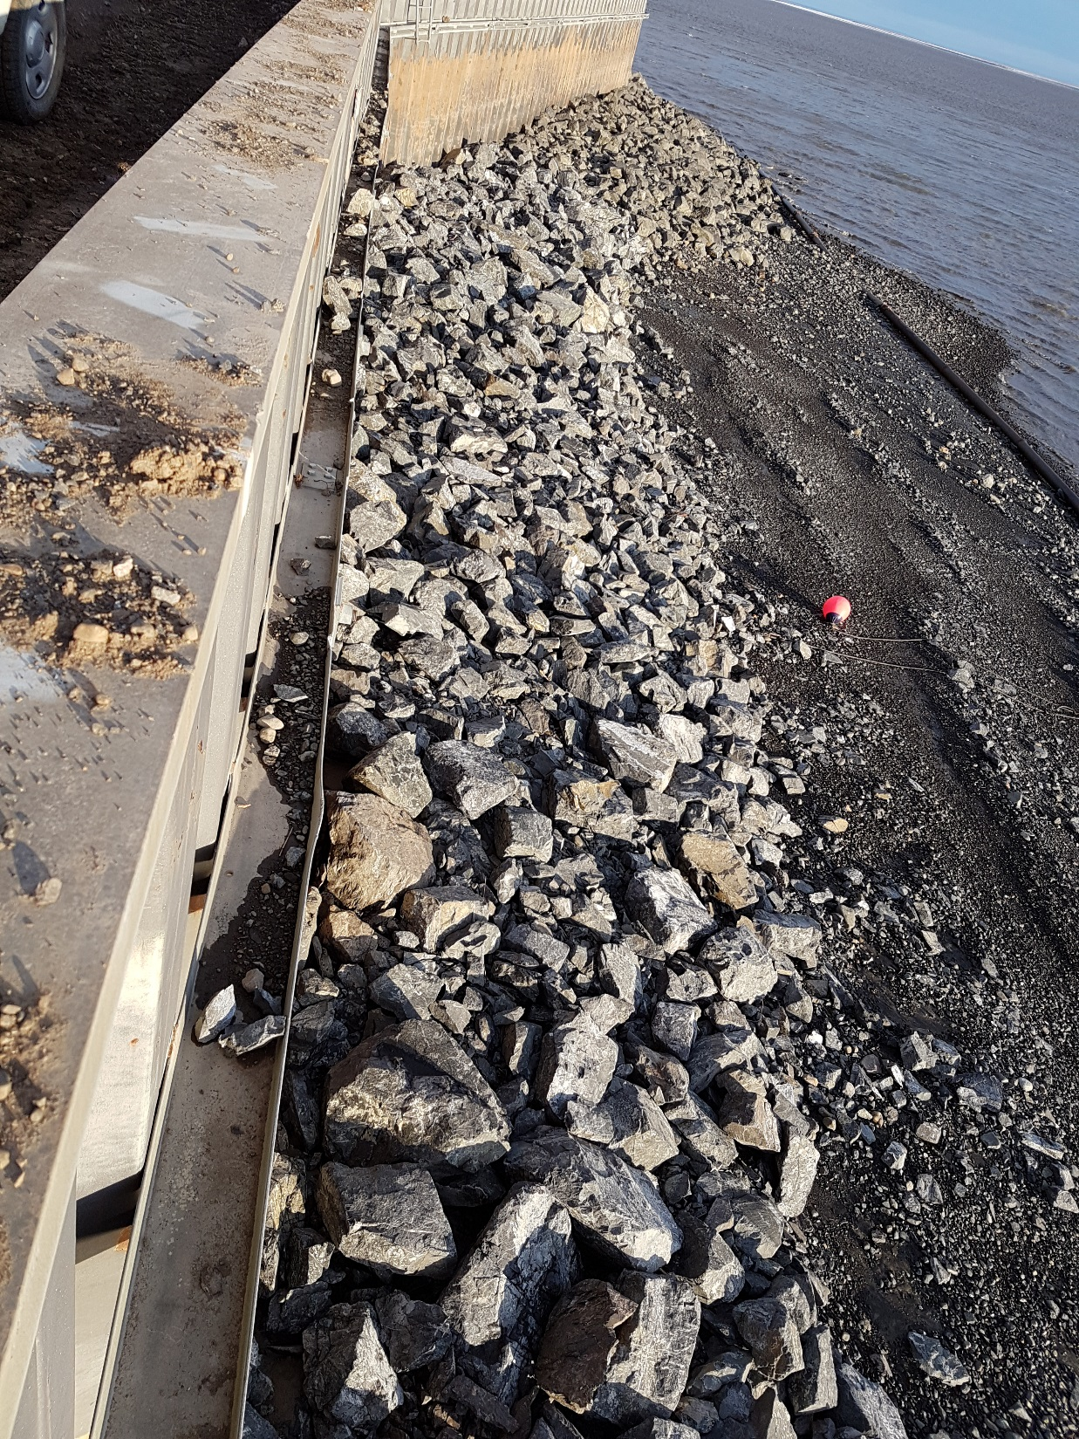
EXHIBIT D-13
Notes:
EXHIBIT D-13

Slide 17
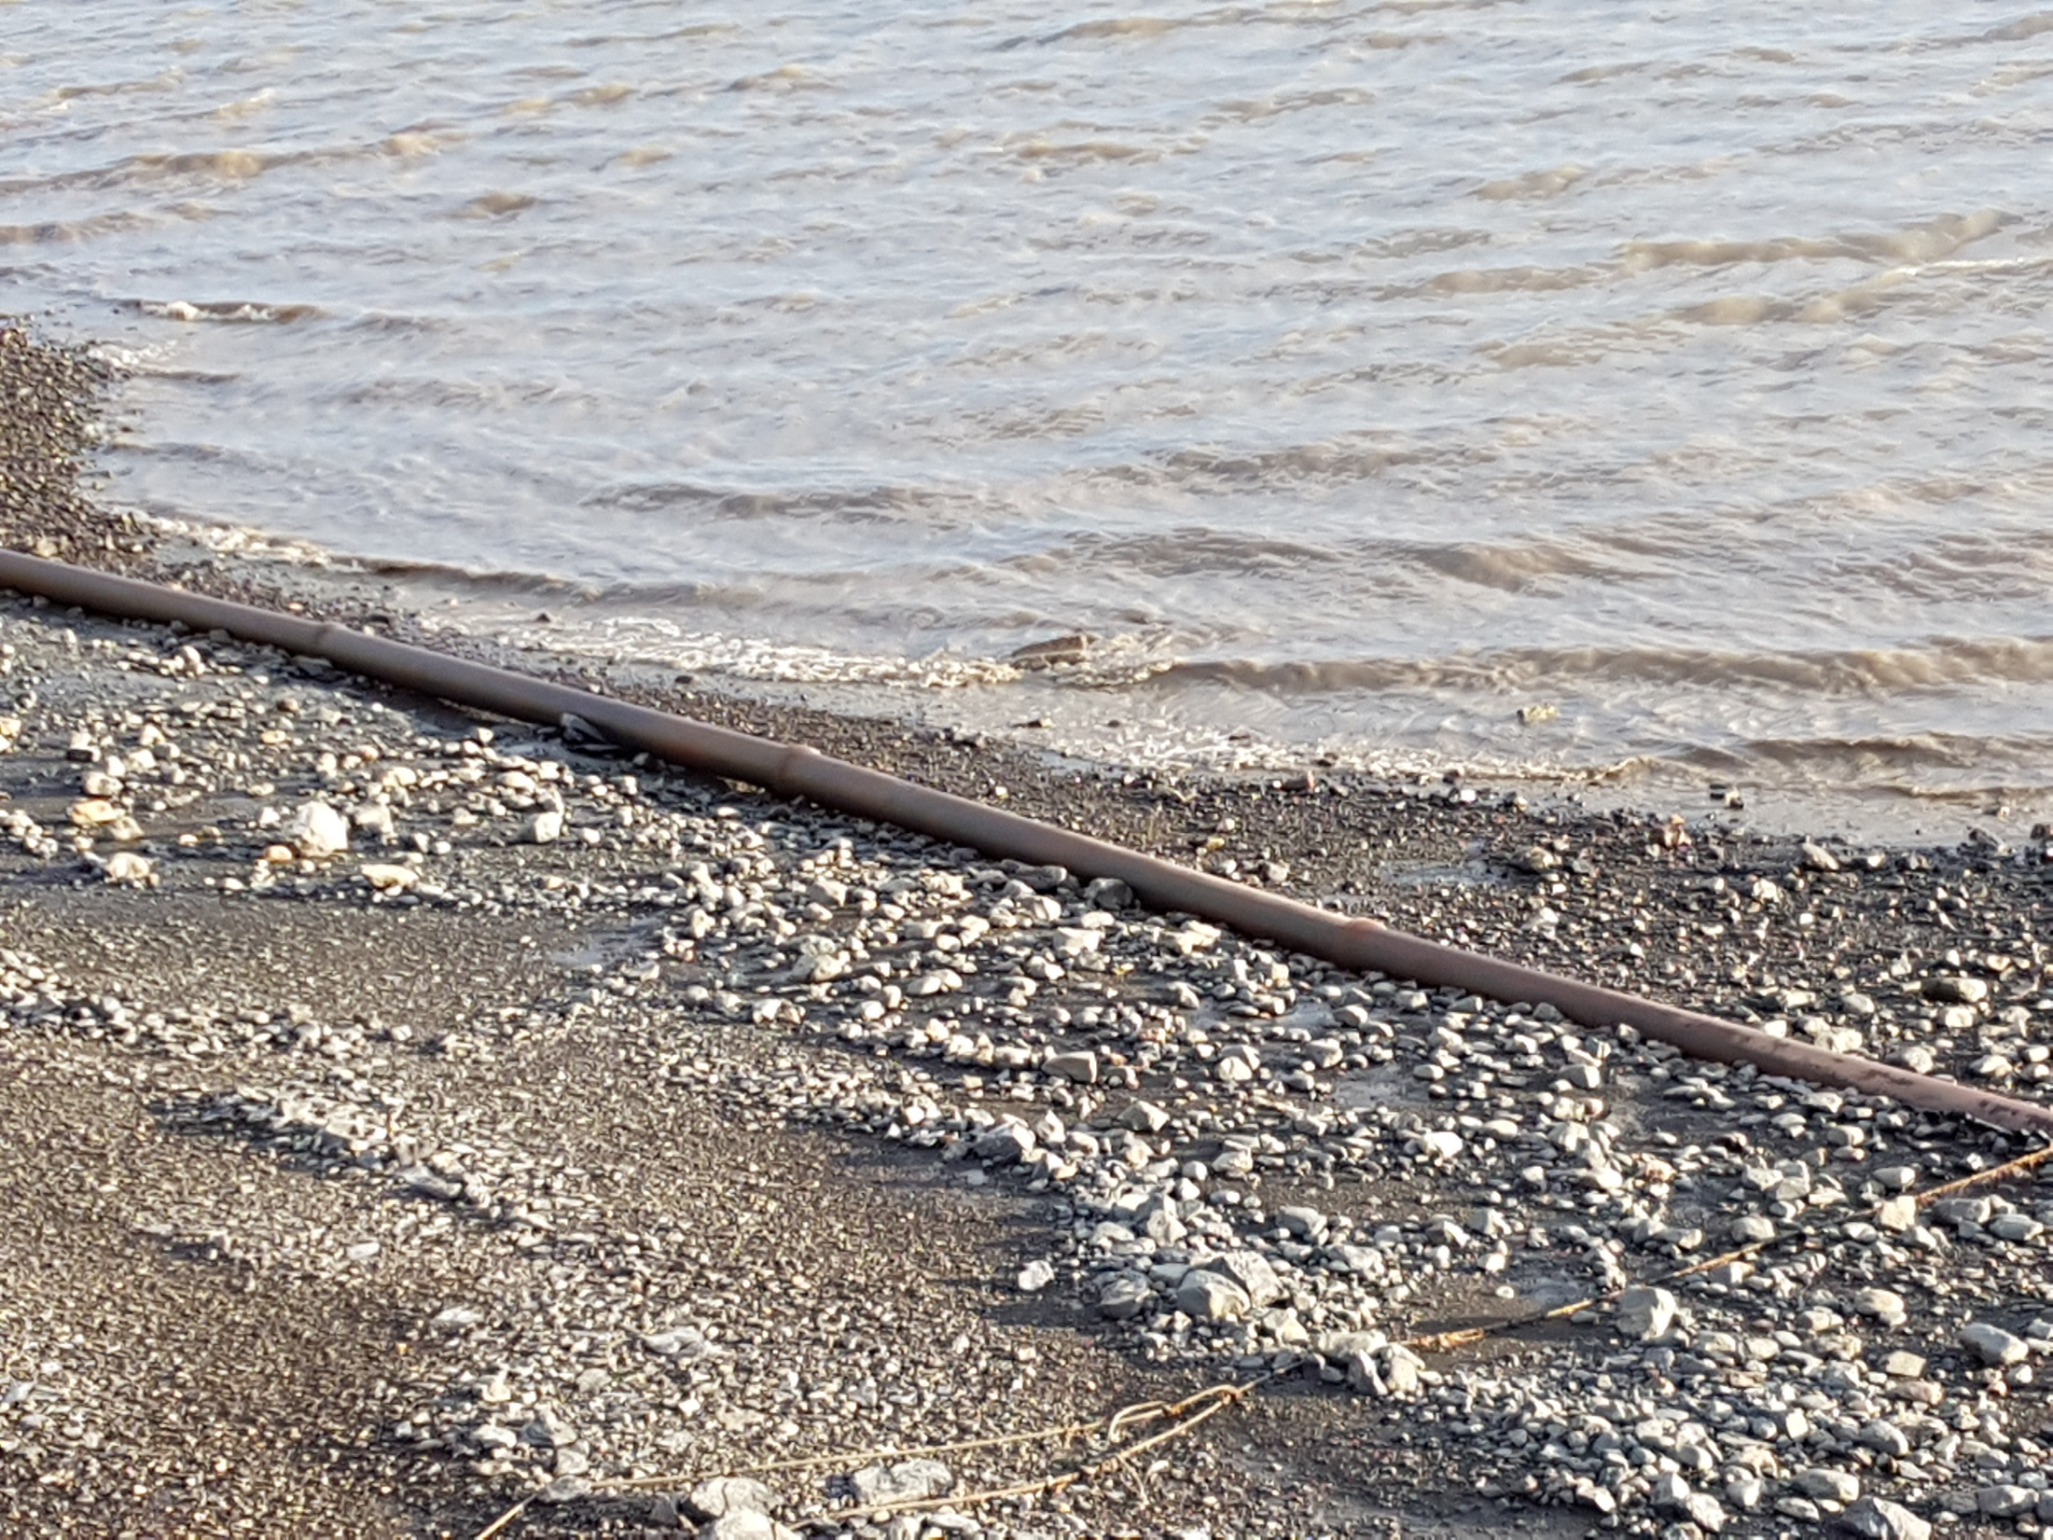
EXHIBIT D-14
Notes:
EXHIBIT D-14

Slide 18
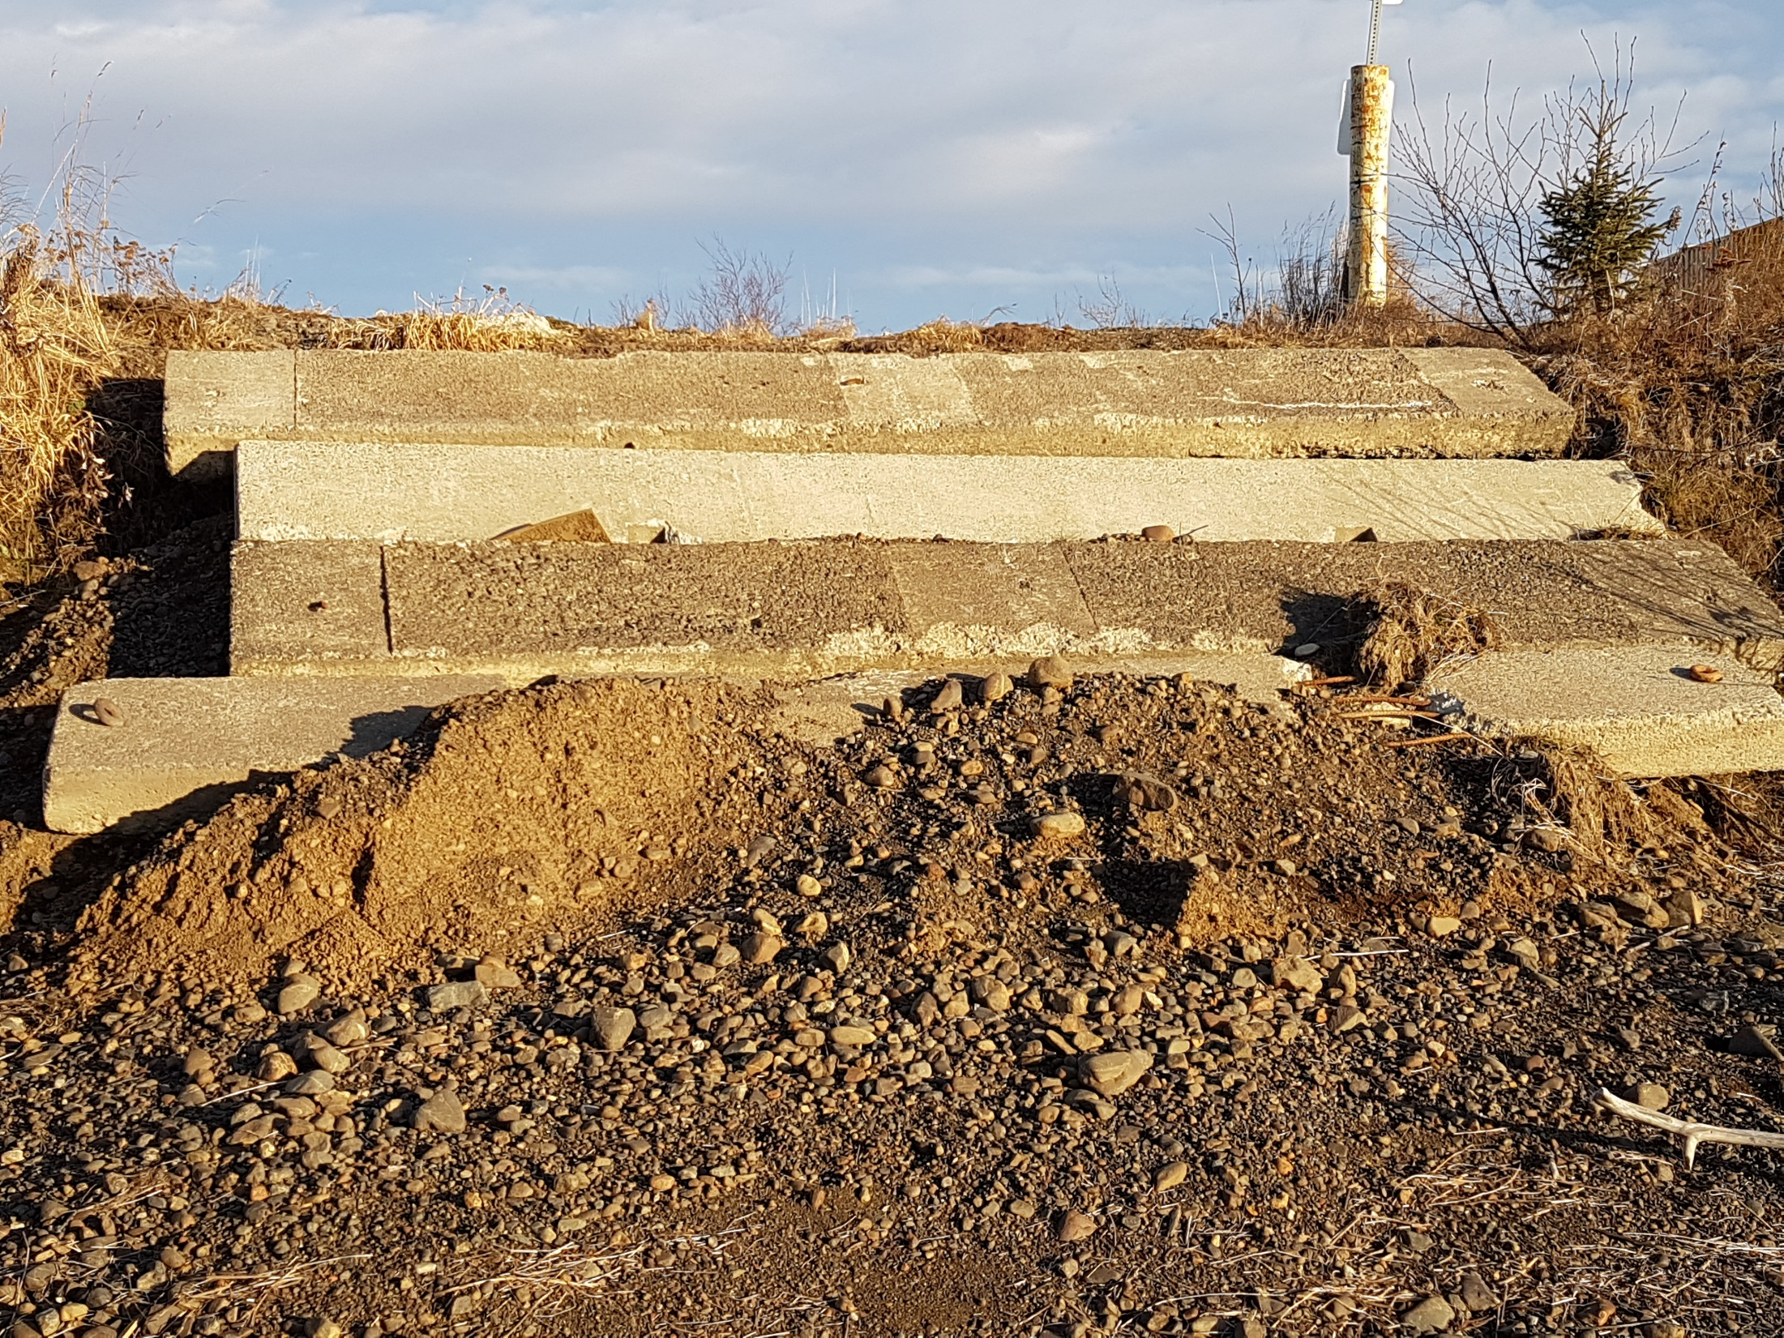
EXHIBIT D-15
Notes:
EXHIBIT D-15

Slide 19
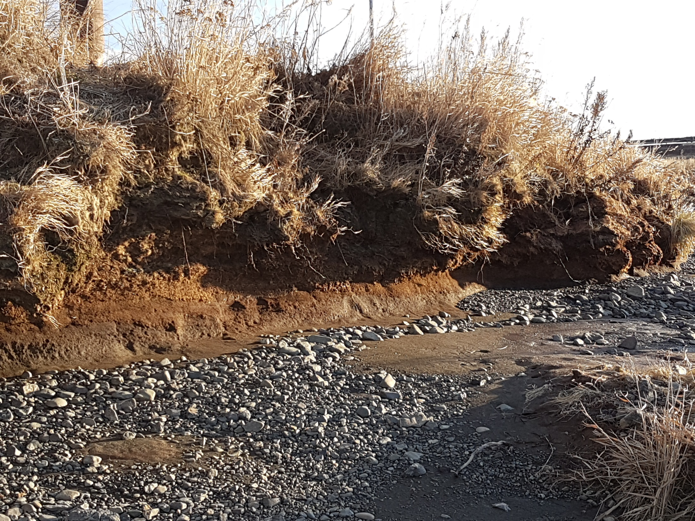
EXHIBIT D-16
Notes:
EXHIBIT D-16

Slide 20
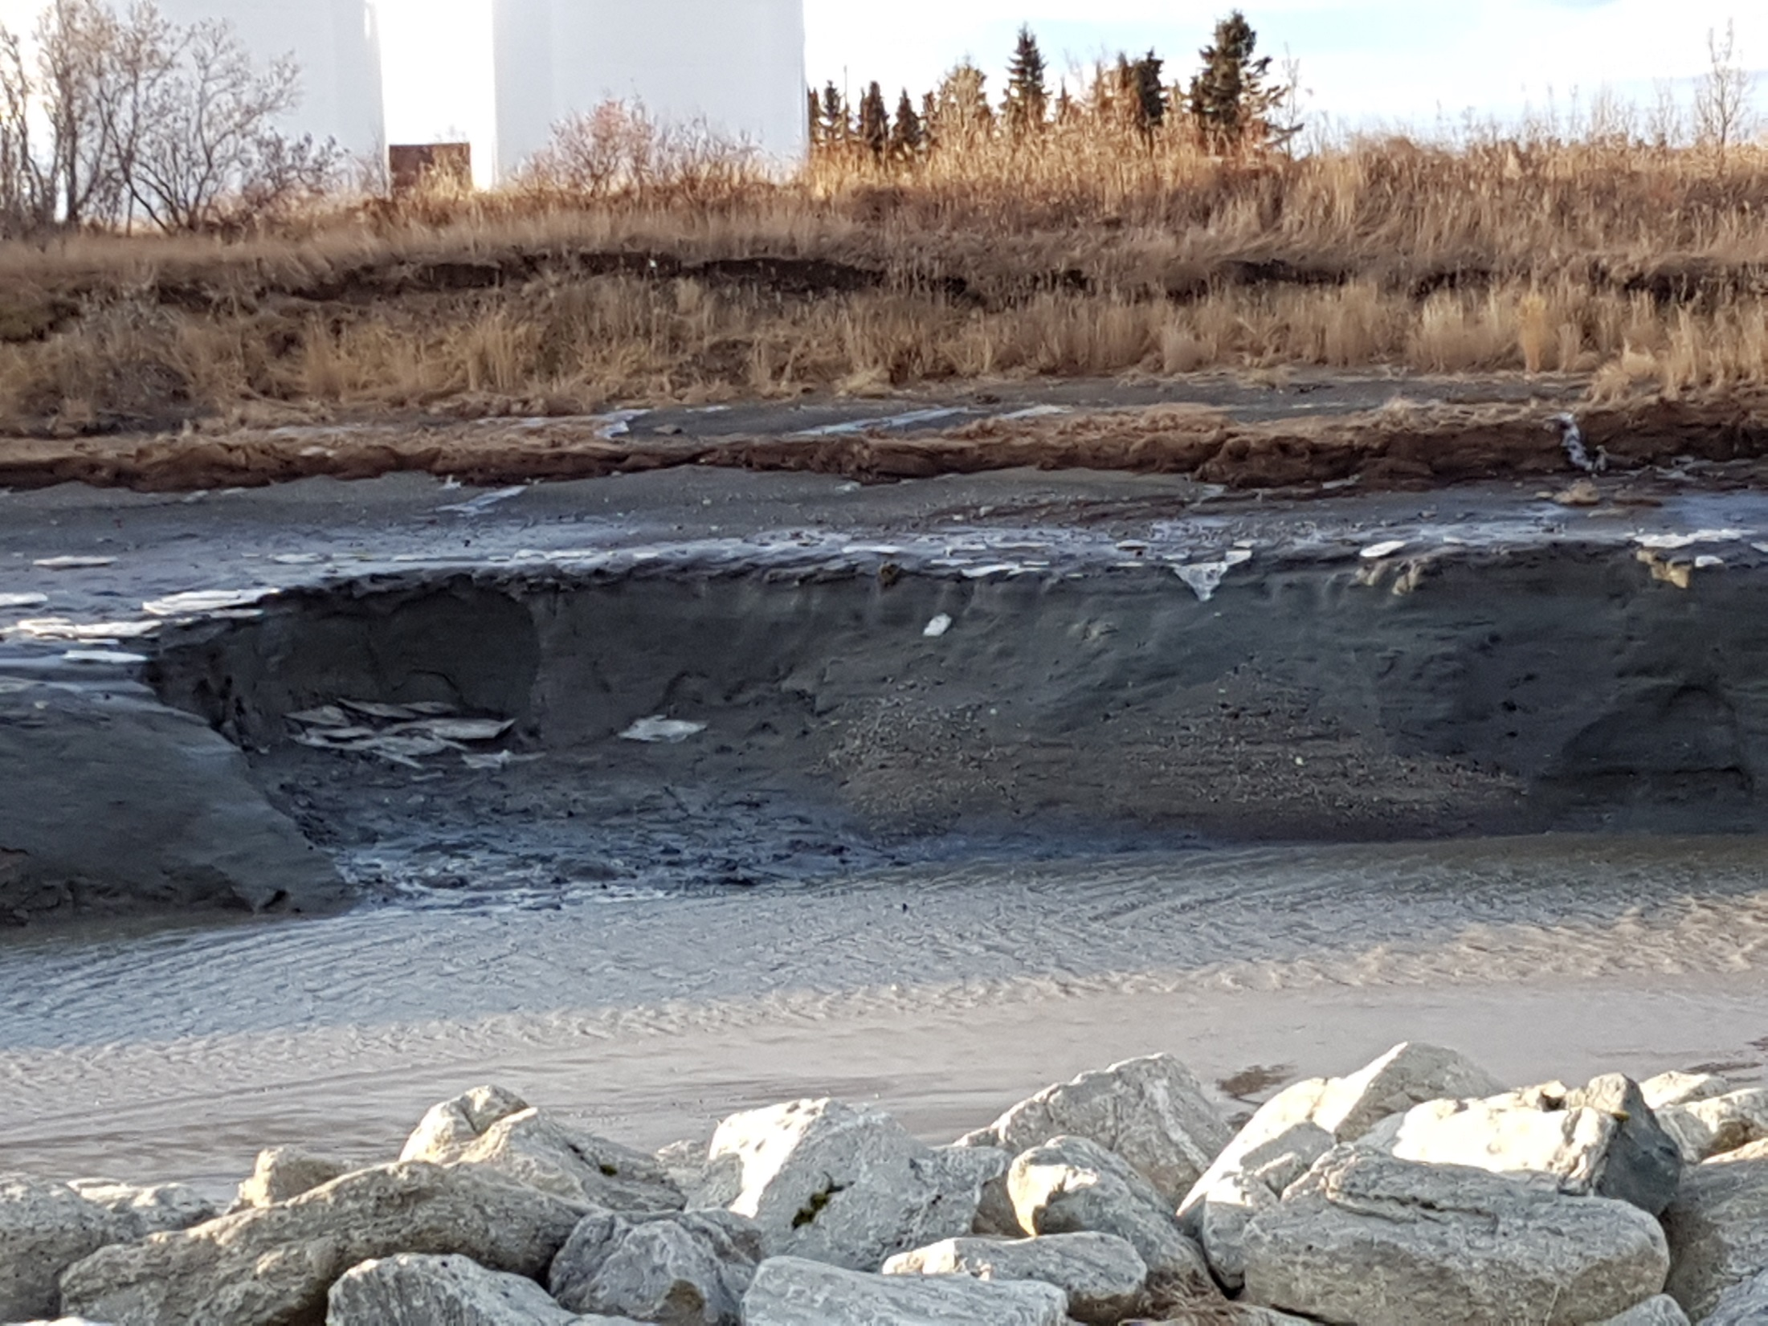
EXHIBIT D-17
Notes:
EXHIBIT D-17

Slide 21
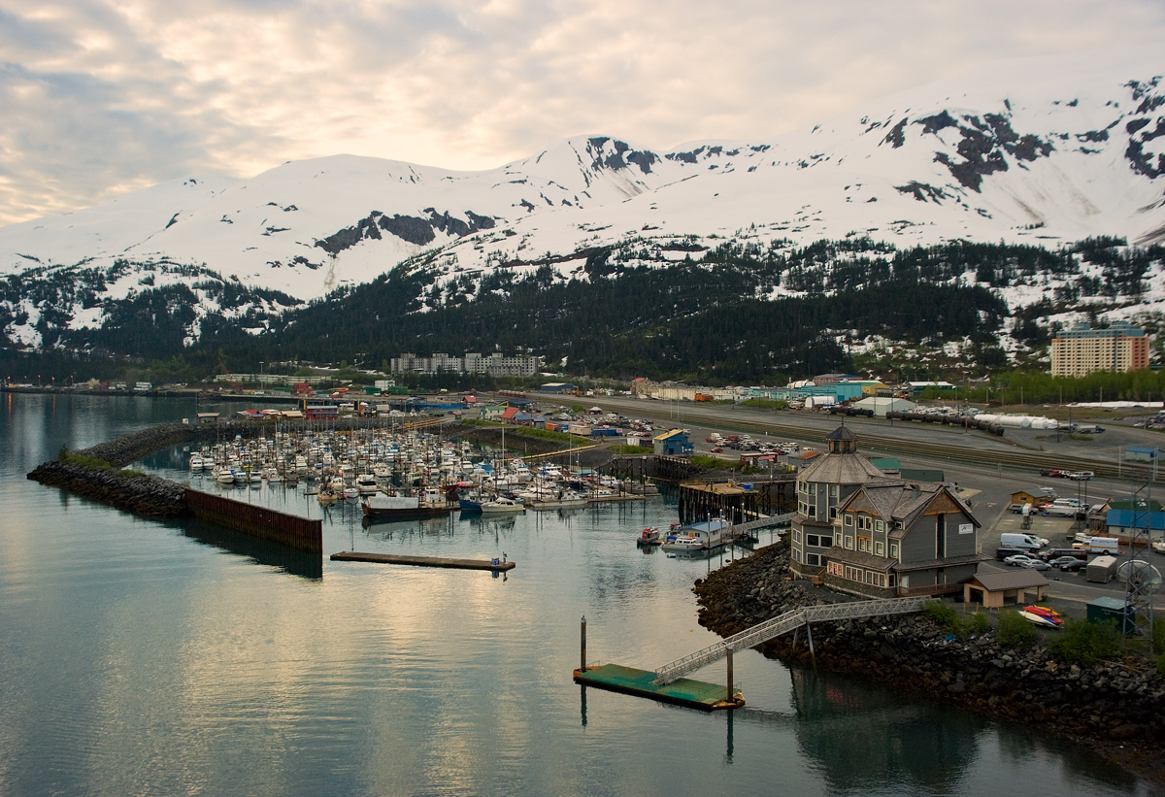
Whittier SMALL BOAT HARBOR
D-6, Page 8 of 8
http://o.aolcdn.com/hss/storage/midas/a63904bbfcbde33f480475c373ab637a/201776152/WhittierAlaska_CondoAirView_Zillow.jpg

Slide 22
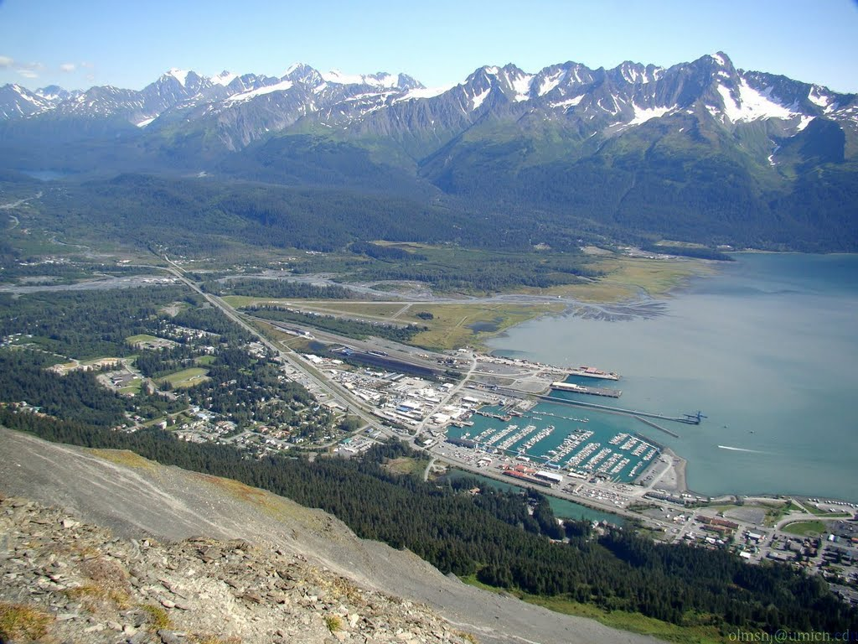
Seward small boat harbor
Exhibit D-6, page 5 of 8
http://static.panoramio.com/photos/large/47443774.jpg

Slide 23
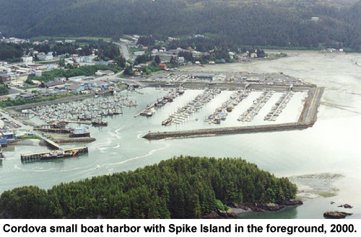
Cordova BOAT HARBOR
Exhibit D-6, page 2 of 8
http://www.mxak.org/ports/southcentral/cordova/harbor_2.jpg

Slide 24
Local Boundary Commission
Excerpts from Decision Approving City of Dillingham Petition to Annex Territory
Dec. 14, 2011

Slide 25
3 AAC 110.090(a)
Regarding the first standard, the commission finds that the territory proposed to be annexed, is receiving, at the present and through the foreseeable future, the benefit of services and facilities provided by the annexing city. The petitioner has continued to provide municipal services. These services would not be available to the fishery industry within the Nushagak Bay area if it were
not for the city providing them. As a responsible local government entity, the city has continually
provided these services at the expense of its residents and to the point of unsustainability.
The proposed annexation will benefit the region as well as the city. The commission finds that 110.090 has been met.
Page 6

Slide 26
3 AAC 110.090(b)
The commission finds no other existing municipality has the ability to provide essential municipal services to the territory to be annexed more efficiently and more effectively than the petitioner. The idea of regional government has only been theoretical with no petition formally filed and accepted by the LBC since the incorporation of the city. Regional government could be a viable option; however, under the circumstances the region has not produced the will or resources necessary to form such a government. The LBC finds that the petition meets 3 AAC 110.090(b)'s requirements.
Page 6

Slide 27
3 AAC 110.100 Character
In a broad view, the Nushagak Bay communities including the City of Dillingham all benefit from the tax revenue the annexation would produce. They would benefit because they use city services, whether for fishing purposes or not. If Dillingham cannot financially sustain itself, these other communities will suffer if these services are no longer available, or are of diminished quality. As the community, in general, benefits from the proposed annexation, it is reasonable to conclude that the territory is suitable for the reasonably anticipated community purpose of producing additional revenue for the direct and indirect benefit of the Nushagak Bay area communities.
We find that the petition satisfies 3 AAC 110.100’s requirements for the territory because the Nushagak Bay is compatible in character to the City of Dillingham.
Page 6

Slide 28
3 AAC 110.110 Resources
The commission finds that the city has met 3 AAC 110.110 because the city has and is expected to continue to provide essential municipal services on an efficient, cost effective level. The local fish tax revenue will provide it the resources to continue to do so. The expenses resulting from this annexation are a minimal portion of the additional revenue accumulated from the severance tax collected, however the petitioner has met 3 AAC 110.110 because the actual income and the reasonably anticipated ability to generate and collect local revenue and income from the territory will fund the essential municipal services that have been continually provided to the territory.
Page 7

Slide 29
3 AAC 110.120
The commission finds that even with a declining population in Dillingham, that the population of the proposed expanded boundaries of the city (the existing city plus the territory proposed for annexation) is sufficiently large and stable to support the extension of city government. The commission believes that in this case, increased tax revenues would stimulate the local economy. This in turn could stabilize or increase population, if residents could stay and have suitable employment. The commission concludes that the petition meets the standard of 3 AAC 110.120.
Page 7

Slide 30
3 AAC 110.130 Boundaries
3 AAC 110.130(a) states that the proposed expanded boundaries of the city must include all land and water necessary to provide the development of essential municipal services in an efficient, cost-effective manner.
The commission finds the city is already providing essential municipal services. The proposed annexation will not make it more difficult for the city to provide these services.
3 AAC 110.130(B)- The commission finds that the territory is contiguous to the city, and would not create enclaves.
3 AAC 110.130( c)(1)- The commission finds that the proposed expanded boundaries of the city are on a scale suitable for city government . . . . Other Alaskan municipalities are reasonably large, on a scale suitable for city (municipal) government. While the proposed expanded boundaries are larger than most other municipalities they are proportionate per capita to other municipalities. The city of Dillingham will be large, but it is not without comparison or precedent. For these reasons, the commission finds that proposed expanded boundaries of the city are on a scale suitable for city government. Page 7-8

Slide 31
3 aac 110.130( C)(2) bOUNDARIES
The commission concludes that the petition meets the standards of 3 AAC 110.090 - 3 AAC 110.135, and are otherwise suitable for city government. Per 3 AAC 110.130(c)(2), because the petition meets those two criteria, the provision that annexation may not include entire geographical regions or large unpopulated areas does not apply.
Page 8

Slide 32
3 AAC 110.135
The annexation further meets the best interests of the state requirement because the city is the appropriate government for the territory. The rest of the region’s communities need a stronger regional hub for their sustainability. The annexation is necessary to sustain the city, thereby sustaining the regional hub. If the city were to continue its fiscal course, without annexation approval, the state could be forced to step in and assist Dillingham in order to maintain the economic integrity of the city and region. This would not be in the state’s best interests. Dillingham is the hub of the Nushagak Bay region.
The city is the appropriate government for the territory because the rest of the region’s communities need a stronger regional hub for their sustainability. We find that the city of Dillingham is the appropriate government for the territory because the city is the region’s hub, because the annexation could encourage, not hinder, borough formation, because the proposed annexation would have no effect upon the number of local government units, and because approving the annexation petition does not remove any present or future fish tax revenue for existing communities or a future borough. Page 10

Slide 33
3 AAC 110.970
The commission finds that the harbor, with its docks and support facilities, is an essential municipal service under the circumstances. We find that it is reasonably necessary to the community. We find this because Dillingham is the largest port in Nushagak Bay, or for quite a distance beyond Nushagak Bay. We find that the docks and related facilities are city owned and maintained, and are essential to the fishers, as either a place to resupply, to seek refuge from weather, and for other boat or crew needs.
We find that 3 AAC 110.970(d) includes “levying and collecting taxes” and “public safety protection” as services which the LBC can consider to be essential municipal services, and we consider them to also be essential municipal services here. We find that the petition has met 3 AAC 110.970’s requirements.
Page 12

Slide 34
3 AAC 110.981
The approval of this petition extends city government to the territory proposed for annexation where no government currently exists. The commission finds that fishers already benefit from the municipal services the city currently provides. Further, the annexation will extend local government to the territory and seasonal population. The commission finds that the proposed boundary change promotes maximum local self government under art. X, sec. 1, Constitution of the State of Alaska.
Page 13

